Slide 1
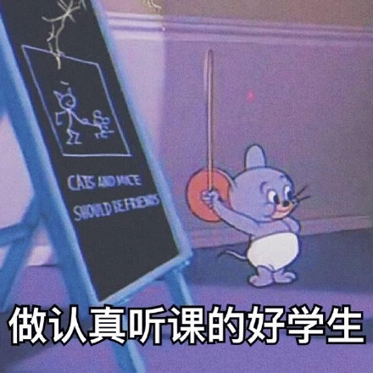
Listen to Learn
The Power of Paying Attention in Class

Slide 2
A Simple Question
Same classroom
Same teacher
Same 45 minutes
Different results — Why?
Notes:
用问题吸引听众：同样的课堂，为什么结果不同？引出“注意力”的关键作用。

Slide 3
Today’s Message
Listening is not passive.
It is an active choice.
Choose to learn, respect, and grow.

Slide 4
Reason 1 — Learn More Efficiently
Teachers explain difficult ideas
They connect knowledge
They highlight key points
Understand more in class → struggle less after class

Slide 5
Reason 2 — Show Respect
Value the teacher’s effort
Respect classmates’ right to learn
A listening classroom grows together

Slide 6
Reason 3 — Build a Lifelong Skill
Meetings
Conversations
Teamwork
Life

Slide 7
The Challenge
Boring lessons (not English)
Tiredness
Phones and friends
Distracting thoughts

Slide 8
How to Listen Better (1)
Prepare your mind and materials
Sit where you can focus
Take key notes — not everything

Slide 9
How to Listen Better (2)
Keep your eyes on the teacher
Follow the flow of the lesson
Ask or write down questions
Remember: every class has value

Slide 10
Make a Commitment
Listen with your ears
Listen with your eyes
Listen with your mind
Not just hear more — become more

Slide 11
Thank You!
Eric

